Slide 1
COVID-19
ANALYSIS OF COVID HASHTAGS IN TWITTER

Slide 2
AGENDA
CONTEXT AND PROBLEM DESCRIPTION
DATA SOURCES
DATA INGESTION
DATA STORAGE
DATA PROCESSING
PROJECT RESULTS
CONCLUSION

Slide 3
CONTEXT AND PROBLEM DESCRIPTION
Almost 780’000 known Covid-19 deaths in the United States only.
The Covid-19 vaccination is a key factor to prevent the virus from further mutating and hence, to end the pandemic.
About 56.7 percent of the worldwide population have received a vaccination, mainly in first world countries.
There is a clear trend of people polarising in either denying covid or embracing covid measures to end the pandemic.
GOAL →
Explore what role Twitter can play in the formation of people's opinion about Covid-19 vaccination.

Slide 4
DATA SOURCES
Social Media Platform
Search API
It is an external and streaming data source.
To get data in JSON format about some specific hashtags.

Slide 5
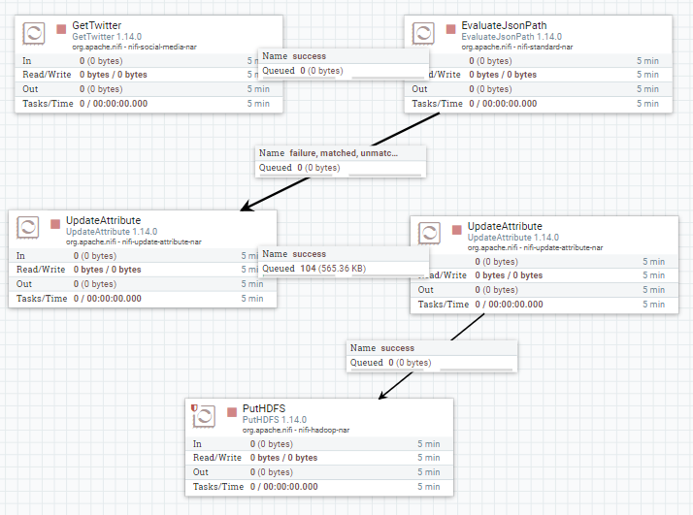
DATA INGESTION
1
Using different processors, we are able to ingest tweets and to create a new attribute (created_at: toDate attribute).
2
Ingest tweets using the getTwitter processor with the languages and hashtags, in two steps:
add the new property “created_at” in the evaluateJsonPath processor,
update it with the present date using the second UpdateAttribute.
3
Create new properties using a new UpdateAttribute processor → create the directory structure with the PutHDFS processor .
#CancelCovid
#ImVaccinated
#HealingStartsHere
#Vaccination
#CovidVaccine
#IGotVaccinated
#TheTruthAboutCovid

Slide 6
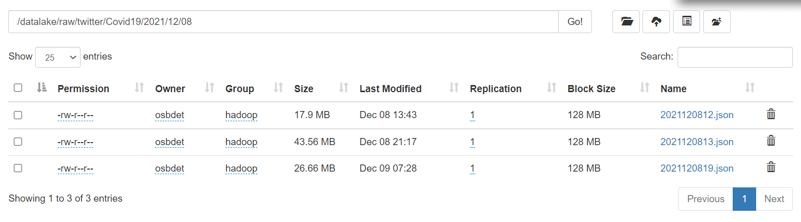
DATA STORAGE
1
2
3
Use hadoop HDFS creating big files to store all the tweets in our own datalake using a distributed file system structure.
Create a raw directory and some specific folders to differentiate our topic (twitter, Covid19).
Use the properties created in the ingestion part (year, month, day) to create a cascade structure with them after our topic .
/datalake/raw/twitter/Covid19/${year}/${month}/${day}/”filename”.json

Slide 7

DATA PROCESSING
HOW TO PROCESS THE DATA?
Use Spark, a batch processing. After creating a DataFrame, analyze and apply new functions to extract insights and information from the dataframe.
HOW TO QUERY THE DATA?
We are querying using python language as we are using High-Level APIS dataframe.
SPARK NOTEBOOK
Data Engineering & Data Analytics
All the analytics are presented in the potential analysis point with its code and results.
Notes:
<a href="https://www.freepik.com/free-photos-vectors/business">Business vector created by pikisuperstar - www.freepik.com</a>

Slide 8
PROJECT RESULTS
Language analysis
Sentiment analysis
Different patterns about Twitter’s usage depending on language:
German speakers less active than the English, Spanish or French speakers.
Tweet is more likely to go viral if it conveys a rather negative sentiment.
Activity analysis
“Omicron” analysis
Most tweets: informational/political accounts
Most mentions: accounts with large audiences (>10’000 followers) and negative sentiment.
Labelled more times positively in the polarity column (in comparison: majority of tweets neutral).

Slide 9
CONCLUSION
The Covid-19 vaccination divides the world’s population into supporters and opponents.
Twitter enables the diffusion of content, that is more likely to become viral if it is in English.
Twitter’s role in how people see covid is similar to that of a catalyst.

